Slide 1
Reason to be Optimistic that we will get to
100% Clean Energy and
80% Redution in GHG emissions before 2050
Its really relatively easy to get to net zero
Just change the demand curve from the bottom up

Slide 2
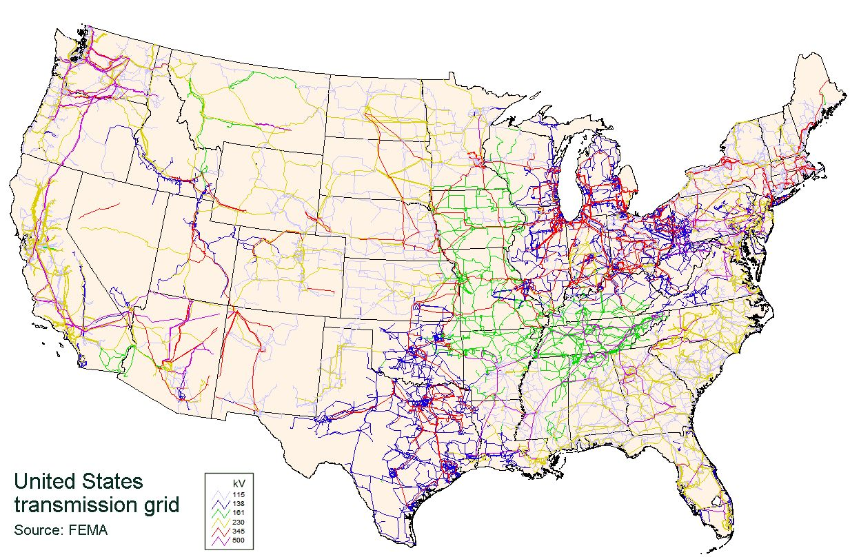
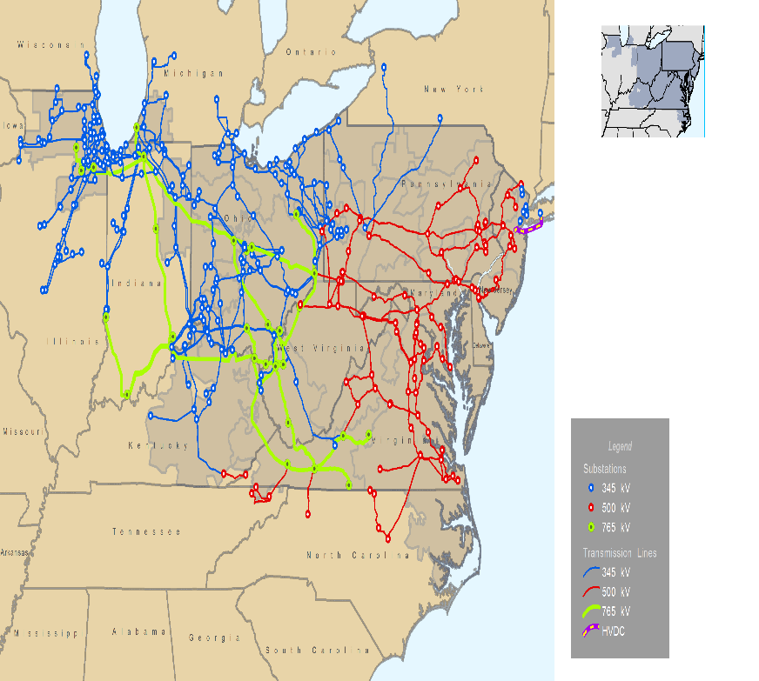

200,000 miles of transmission lines and 5.5 million miles of distribution wires

Slide 3
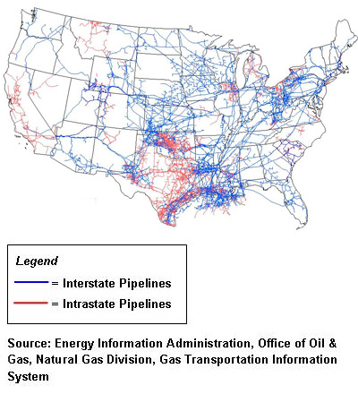
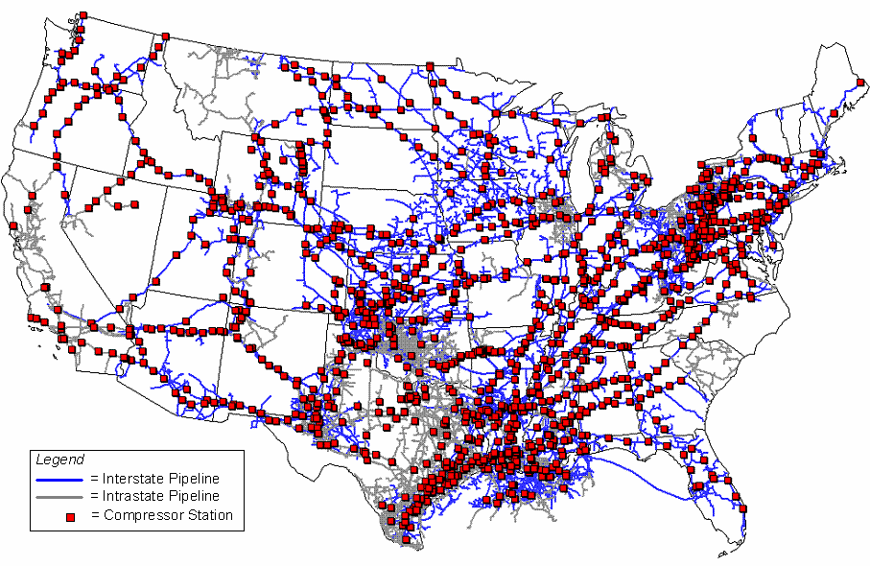
300,000 miles of inter and intrastate pipelines and 2.1 M miles of distribution pipes

Slide 4

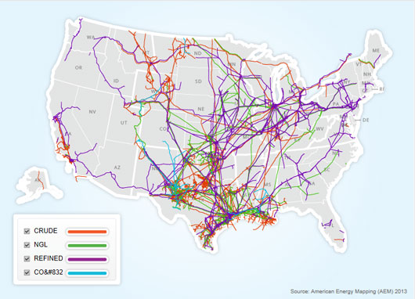
193,000 miles of fuel oil pipelines in US

Slide 5
Energy is Carbon - Seven Basic Facts of Energy and Climate Change by Mike Winka
Work makes the world go round and you need to generate energy to do work.
Almost all the energy we generate comes from the combust of fossil fuels.
Fossil fuels are just organic matter sequestered over millions of years – the organics
matter on the earth today will be fossil fuel millions of years from now.
When you burn fossil fuels for energy you release the sequestered
matter that was in the fossil fuels one of which is CO2 as part of the combustion process.
Coal has more sequestered matter than oil and oil more than natural gas.
There is no end of the pipe control technology for CO2 – if there were there would
be no debate on the science of climate change
Increasing CO2 increases temperature, increasing temperature increases energy in weather impacts
and the volume of water which leads to sea level rise.
It is not climate change that is the issue climate will always change –
It is the rate of change – can we adapt to the rate of change

Slide 6
Basics of Climate Change and the Science of Energy by Mike Winka
Heat - Energy - Work
C_{x} H_{y} + nO₂ = x CO₂ + y/2 H₂0 +
CH₄ 16 g/mole 44 g/mole
_{n = x + y/4}
NOx SO2 Hg PM minimized with
Back-end air quality control technology
Work makes the world go round - You have to produce energy to do work
And it cost real money to generate energy
Sustainability is that ability to transfer energy to move heat or do work with the least amount of negative environmental, economic and equity impacts
CO2 emissions cannot be control with back–end air quality control technology
The control technology for reducing CO2 emissions is:
Make it Cleaner or more Efficient – Renewable Energy and Energy Efficiency

Slide 8
32%
43%
Mostly gasoline

Slide 9
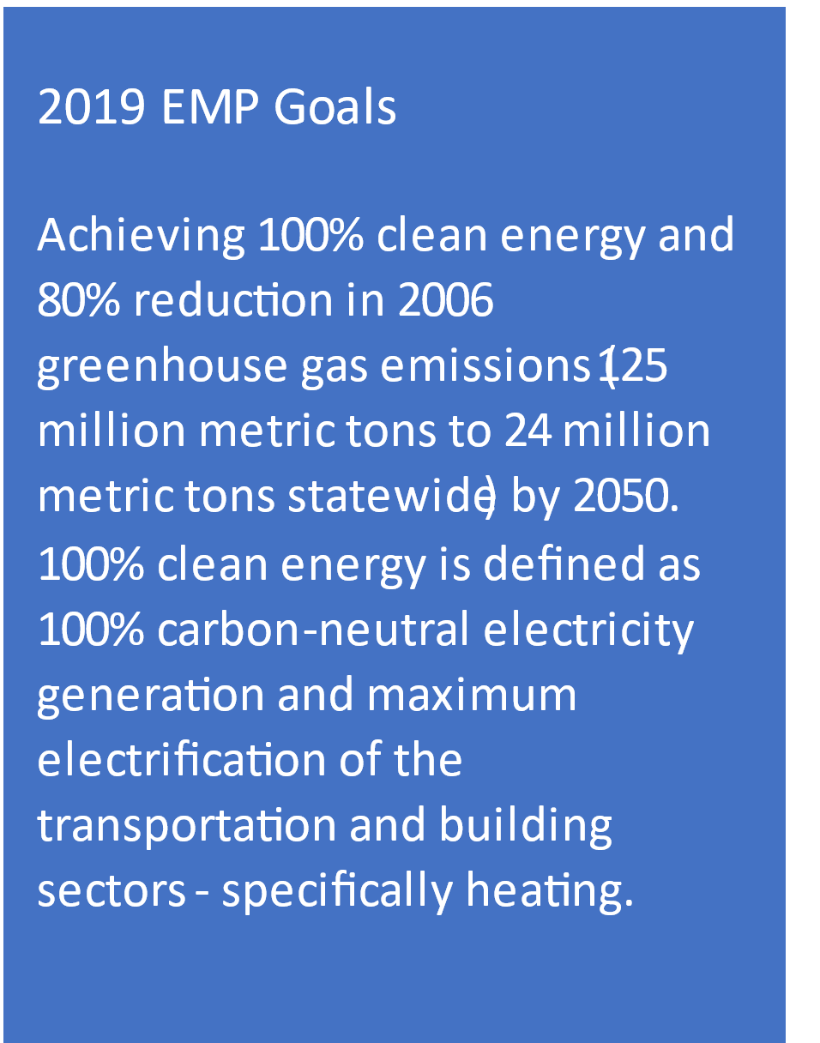
2019 Energy Master Plan – Strategies to get to 100% Clean Energy by 2050
The EMP puts mitigation in buckets – more integrated approach

Slide 10
To get to 50% by 2030
Requires more than the 2019 EMP or about 30 MMT less

Slide 11
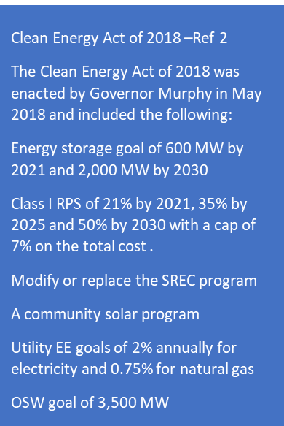
To get to 50% by 2030
Requires more than the 2019 EMP or about 20 MMT less

Slide 12
40% less energy

Slide 13
2019 Energy Master Plan – Costs and Benefits
The overall cost is a 0.2% increase in New Jersey’s total GDP at an estimated cost of $2.1 billion and a benefit of $4.2 to $6.3 billion. That is a benefit to cost ratio of 2 times to 3 times. A benefit to cost ratio that is greater than one is defined as cost effective.

Slide 14
From the 2019 Integrated Energy Plan presentation – November 2018

Slide 15

NJ Electricity Sales with and without EE, Solar and Appliance Standard Savings
Please note: Estimated annual electricity savings in 2016 are 10 million MWh. Total electricity savings from 2009 to 2016 is represented by the area beneath the curve.
http://njenergydata.rutgers.edu/

Slide 16
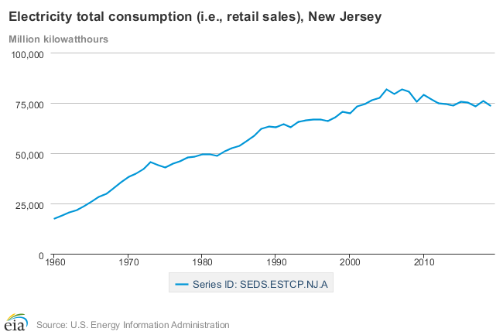
Pre-1973 Energy Policies were Economic Policies – that changed with Energy Efficiency
Great Recession
1st Gulf war
9/11 and 2nd Gulf war
1st oil embargo
> Electricity usage - 40% from 110 M MWh to 75 M MWh
> Electricity cost - $3.5billion/year in 2020 from $13.5B to $10 B
> in percent of state GDP to around from 8% to 4%
2nd oil embargo/Iran
>8.4 million metric tons of avoided CO2 emissions per year

Slide 18
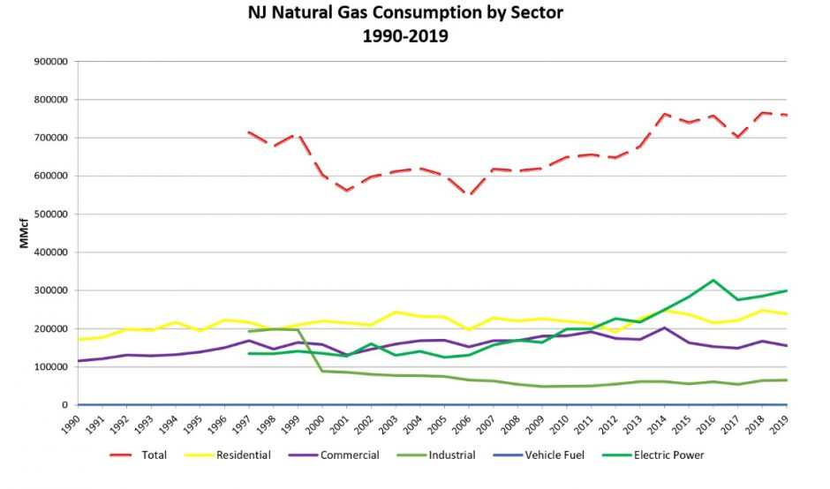

Slide 19
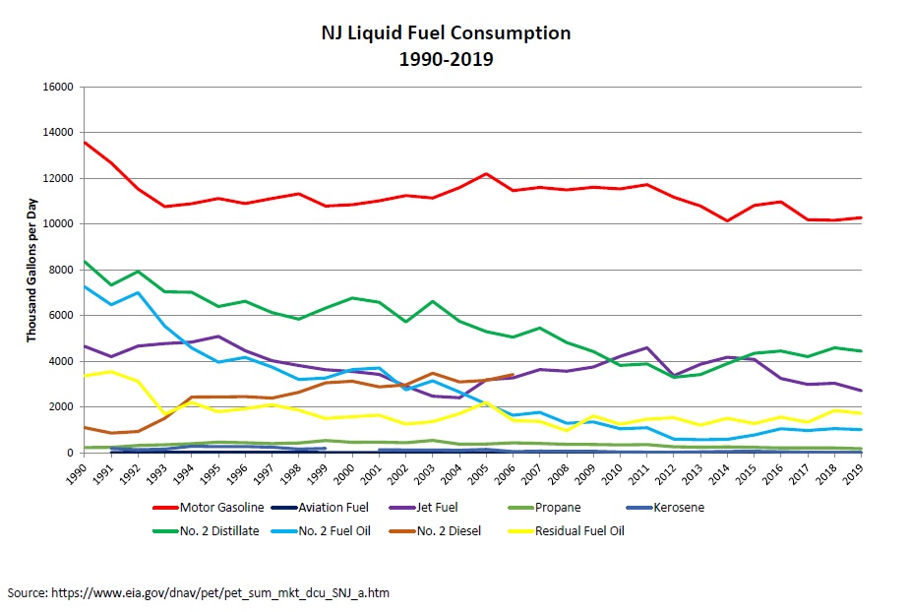

Slide 20
New Jersey’s Progress to achieving its GHG emissions reduction goals and more

Slide 21

Renewable Energy Certificates (RECs)
Renewable Generator:
Production of
Renewable Energy
Commodity Electricity
Environmental Benefits
(S0₂, NO_{X},CO₂ )
New Jersey REC or
Solar REC -1 MWh
Electric Supplier:
Retires the REC
Load Serving Entities
Certificates represent the environmental benefits and other attributes associated with electricity generated from a renewable energy generator . May be traded independently of underlying electricity.

Slide 22

What is a Solar Renewable Energy Certificate (SREC) ?
How Does the SREC Market Works to help pay for your Solar
RPS
Buy
Sell
SREC
Market
PJM –EIS
GATS
LSE’s
Solar
Projects
Or the LSE can Choose to pay the Solar
Alternate Compliance Payment (SACP) upper limit on price (cap)

Slide 23
How Clean Energy Policy Changes over time – to achieve larger goals

Slide 24
To get to 100% clean energy by 2050 or
80 x 50 or 50 x 30
You don’t really need a federal carbon tax or
a federal clean electricity standard or a state
carbon cap and trade
Nice to have but not needed to mitigate the
impacts of greenhouse gas emissions today
You beat this large energy system
“From the inside out”

Slide 25
Five Simple Currently Cost Effective (even without subsidies) Clean Energy Technologies (EE/RE) that can be Implemented Incrementally to Mitigate Climate Change by Reducing Greenhouse Gas Emissions
Solar (RE)
Storage (CE)
Electric Vehicles (EE)
Heat Pumps (EE)
Smart Grid (CE)

Slide 26
What is your household Carbon Footprint
Just need to know your household annual energy usage
Annual household electric use – electric bill
Annual household natural gas use – natural gas bill
Annual household gasoline use – gasoline bills/mileage
Your household CO2 =
energy usage * emission factor (lbs/unit of energy)

Slide 27
Household Energy use assumptions
2,400 sq ft single family home
3 member household 2 adult 1 child under 18
2 average fuel economy cars driven the average miles/ year
Gasoline – per EPA/DOE and USDOT-FHWA
13,000 miles/year/vehicle * 2 / 25 miles/gal = 1,000 gals/yr
Natural Gas per EIA average eff furnace and hwh = 1,000 therms per year
Electricity per EIA average CAC and lighting = 9,000 kWh per years

Slide 28
Gasoline
1,000 gal/yr * 19.6 lbs of CO2/gal = 19,600 lbs of CO2/yr
$3.20/gal * 1,000 gal/yr = $3,200/yr (4% annual cost at medium income)
Natural gas
1,000 therms/yr * 11.7 lbs of CO2/therms = 11,700 lbs of CO2/yr
$1.10/therm * 1,100 therms/yr = $1,100/yr (1.4% at medium income)
Electricity
9,000 kWh/year * 0.75 lbs of CO2/kWh = 6,750 lbs of CO2/yr
$0.165/kWh * 9,000 kWh/yr = $1,500 (2% at medium income)
Total = 40,010 lb of CO2 / HH or 20 T/HH - $5,800/yr (7% at medium income)

Slide 29
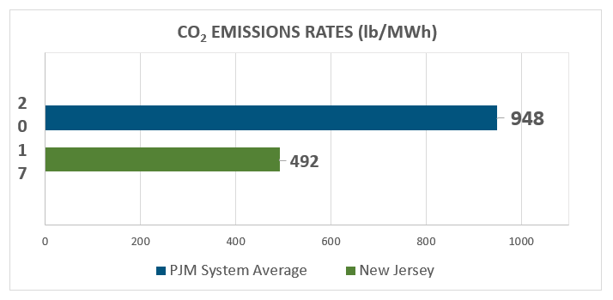
Electric Generation Facilities in-state Emissions Rate
PJM avg
US average
884 #/MWH
New Jersey

Slide 30
Total HH energy cost - $5,800 per year Total HH carbon footprint 40,000 # - 18 MT
Your HH CO2 footprint is 0.00004% of NJ total and 0.0000007% of US total
NJ 115 MMT of CO2 US 6,500 MMT of CO2 and 433,000 MMT of CO2 Global
NJ is < 2% of US total CO2 emissions and US is 15% of Global CO2 emissions

Slide 31
Your electric bill and Natural gas heating usage and costs
www.pseg.com/home/save/manage_costs/tips_tools.jsp
https://www.firstenergycorp.com/save_energy/save_energy_new_jersey/for_your_home_nj.html
https://www.njng.com/save-energy-money/ctp/index.aspx
Home Energy Calculator
https://nj.pseg.com/saveenergyandmoney/energysavingpage/homeenergyanalyzer
https://www.firstenergycorp.com/save_energy/home_energy_analyzer.html
https://www.njng.com/save-energy-money/ctp/dashboard.aspx
Fill in question on Home type/age, insulation, windows,
HVAC, HWH, Refrig/Freezer, TV, Kitchen …

Slide 32
 | kWh | Electric Costs
Cooling | 6,929 | $1,142
Heating | 498 | $73
Refrigerators/Freezers | 511 | $78
Lighting | 288 | $44
Dishwasher | 49 | $7
Clothes Washer | 28 | $4
Clothes Dryer | 469 | $72
Elec. Base Charge | N/A | $29
Total Per Year | 8,771 | $1,450
Average Per Month | 731 | $121

Slide 33
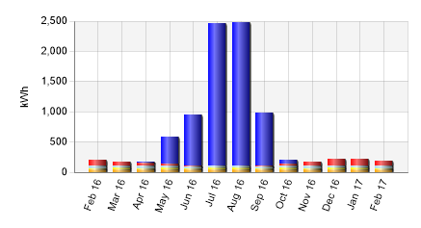

Slide 34
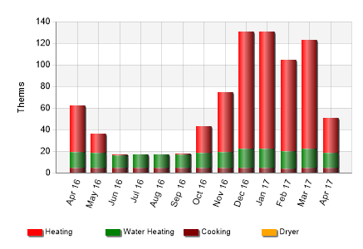

Slide 35
How much solar do you need for an average
Single family home (SFH) approx. 2,500 sq ft
Rule of Thumb – 1,100 kWh per year per KW installed
- 1,200 kWh/kW for HE panels
Solar panels = 45 sq ft / kW to 60 sq ft / kW
SFH uses
9,000 kWh /1,100 = 8 kW
9,000 kWh /1,200 = 7.5 kW
7.5 kW X 50 sq ft/kW = 375 sq ft – 24 solar panels
375 sq ft = 16 ft X 24 ft - 3 rows of 8 solar panels

Slide 36
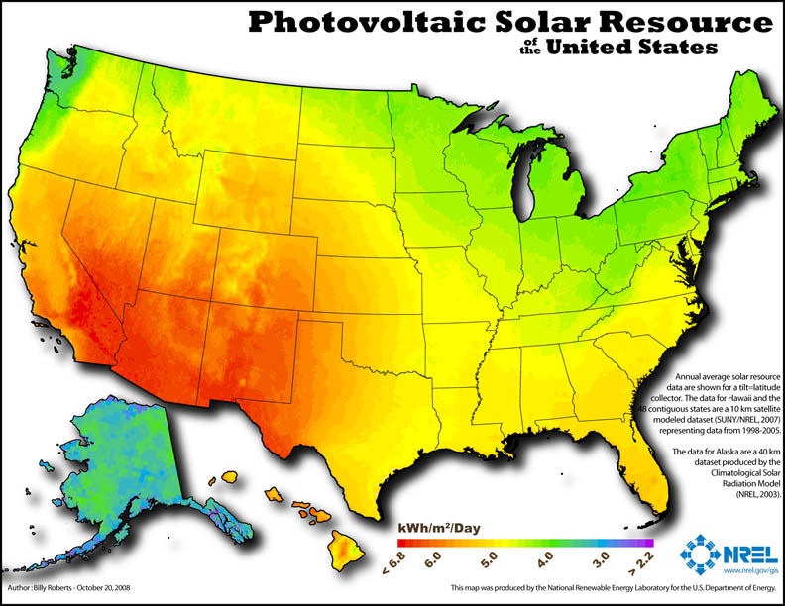
1m² = 10.76 ft²

Slide 37
NREL’s solar installation model – PV WATTS http://pvwatts.nrel.gov/
http://www.njcleanenergy.com/files/file/Renewable_Programs/NJCEPPVWattsCalculatorTraining21815.pdf
DC System Size (kW): 7.0
Module Type: Standard
Array Type: Fixed (open rack)
System Losses (%): 14
Tilt (deg): 20
Azimuth (deg): 180
Draw Your System - customize your system on a map. (optional)
Average Cost of Electricity Purchased from Utility ($/kWh): 0.165
NREL solar installation, performance cost and financing model -
System Advisor Model SAM https://sam.nrel.gov/

Slide 38

NREL’s solar installation model – PV WATTS http://pvwatts.nrel.gov/
Month | Solar Radiation( kWh / m2 / day ) | AC Energy( kWh ) | Energy Value( $ )
January | 2.78 | 527 | 95
February | 3.52 | 596 | 107
March | 4.34 | 793 | 143
April | 4.95 | 844 | 152
May | 5.69 | 974 | 175
June | 5.86 | 946 | 170
July | 5.73 | 945 | 170
August | 5.47 | 894 | 161
September | 4.91 | 799 | 144
October | 3.99 | 694 | 125
November | 2.68 | 471 | 85
December | 2.35 | 438 | 79
Annual | 4.36 | 8,921 | $ 1,606
7.0 KW south facing at 20º tilt

Slide 39
July and August electricity usage = 1,500 KWh/month
more than the PV system generates = $250/month

Slide 40
Month | Solar Radiation( kWh / m2 / day ) | AC Energy( kWh ) | Energy Value( $ )
January | 2.78 | 527 | 95
February | 3.52 | 596 | 107
March | 4.34 | 793 | 143
April | 4.95 | 844 | 152
May | 5.69 | 974 | 175
June | 5.86 | 946 | 170
July | 5.73 | 945 | 170
August | 5.47 | 894 | 161
September | 4.91 | 799 | 144
October | 3.99 | 694 | 125
November | 2.68 | 471 | 85
December | 2.35 | 438 | 79
Annual | 4.36 | 8,921 | $ 1,606
July and August electricity usage = 500 KWh/month
More than the PV system generates = $250/month

Slide 41
Step 4. Calculate your cost
7 kW X $3 per watt installed = $21,000
Exempt from sales tax – Exempt from property tax >
26% federal Investment tax credit ITC = $5,460
$15,540 is the net cost of the 7 kW solar PV system after accounting for your ITC

Slide 42
USDOE NREL and LBL Tracking the Sun
https://emp.lbl.gov/sites/default/files/2_tracking_the_sun_2021_report.pdf
https://www.nrel.gov/docs/fy21osti/77324.pdf

Slide 43
Step 5. Calculate your simple payback
Total cost / total annual revenues = years needed to pay for the system
You need to know the value of your:
Avoided retail electricity cost from Net Metering
Value of Solar Renewable Energy Certificate SREC II
How long will you receive these revenues

Slide 44
ADI Capacity Blocks by Market Segment
Market Segments | System Size MW (dc) | Incentive Values ($/SREC-II) | *Public Entities (($20 Adder)
Net-Metered Residential | All Sizes | $90 | N/A
Small Net-Metered Non-Residential located on Rooftop, Carport, Canopy and Floating Solar | Projects smaller than 1 MW (dc) | $100 | $120
Small Net Metered Non-Residential Ground Mount | Projects smaller than 1 MW (dc) | $85 | $105
Large Net Metered Non- Residential located on Rooftop, Carport, Canopy and Floating Solar | Projects 1 MW to 5 MW (dc) | $90 | $110
Large Net Metered Non-Residential Ground Mount | Projects 1 MW to 5 MW (dc) | $80 | $100
Community Solar LMI | Up to 5 MW (dc) | $90 | N/A
Community Solar Non-LMI | Up to 5 MW (dc) | $70 | N/A
**Interim Subsection (t) Grid | All Sizes | $100 | N/A
Market Segments | System Size | MW (dc) Capacity Blocks
Net-Metered Residential | All Sizes | 150 MW
Net Metered Non-Residential | All sizes at or below 5 MW (dc) | 150 MW
Community Solar including LMI and Non-LMI | All sizes at or below 5 MW (dc) | 150 MW
Interim Subsection (t) Grid | All Sizes | 75 MW (Interim Basis)
https://njcleanenergy.com/renewable-energy/programs/susi-program/adi-program

Slide 45
Step 5. Calculate your simple payback
The New Jersey Solar Incentive is now a feed-in-tariff
Successor Solar Incentive (SuSI) – SREC II
The incentive is administratively determined
Value of SuSI is fixed based on blocks
Residential IX - $90 per MWh or per SREC II
Qualification life = 15 year

Slide 46
Step 5. Calculate your simple payback (SPB)
Method to calculate SPB
Total cost for a 7 kW system w/o ITC = $21,000
Total cost for a 7 kW system after 26% ITC = $15,540
Avoided electricity generated at 8,900 kWh per year
Annual value for NM/IX at $0.165/kWh = $1,468 per year
SREC II generated = 8.9 per year
SuSI – ADI at $90 per MWh = $801
Total solar revenues = $1,468 + $801 = $2,269/year

Slide 47
Step 5. Calculate your simple payback
SPB Results
$15,700 / $2,269/year = 6.85 years with ITC – NM/IX – SRECII
Estimated ROI = 14.5%
$21,000 / $2,269/year = 9.26 years w/o ITC with NM/IX – SRECII
Estimated ROI = 10.8%
$15,700 / $1,498/year = 10.48 years with ITC with NM/IX
Estimated ROI = 10.5%
$21,000 / $1,498/year = 14 years w/o ITC with NM/IX
Estimated ROI = 7.1%

Slide 48
Step 6. Options to Purchase your solar
Pay Cash upfront
Finance through a loan 10/15 year loan
Lease your roof space 15 + year lease
Power Purchase Agreement – buy solar e⁻ for 15+ years
Evaluate your costs and benefits within your risk profile
https://www.njcleanenergy.com/renewable-energy/tools-and-resources/ownership-financing-options
https://www.cesa.org/wp-content/uploads/Homeowners-Guide-to-Solar-Financing.pdf
NREL System Advisor Model SAM https://sam.nrel.gov/
CREST Cost for Renewable Energy Spreadsheet Tool
https://financere.nrel.gov/finance/content/crest-cost-energy-models

Slide 49
NREL U.S. Solar Photovoltaic System and Energy Storage Cost - Benchmark: Q1 2020
Added $10K to PV system cost
for ¼ of the PV average output
Double the PV system cost for
the PV average daily output
https://www.nrel.gov/docs/fy21osti/77324.pdf

Slide 51
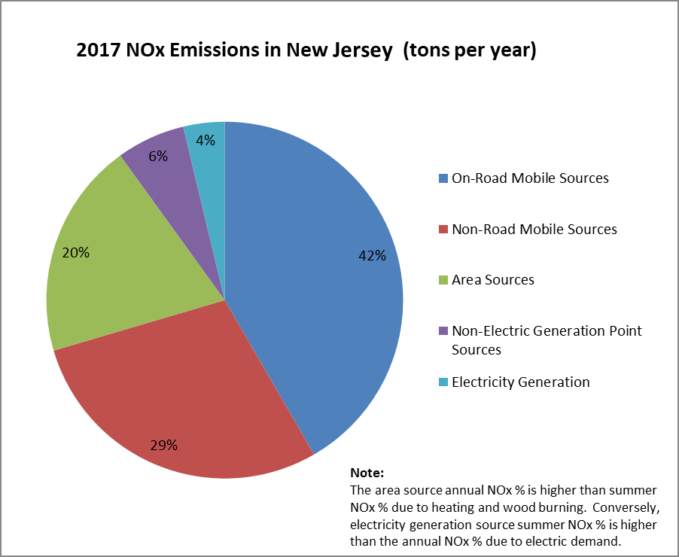

Slide 52
Total HH energy cost - $5,800 per year Total HH carbon footprint 40,010 # - 20T
Your HH CO2 footprint is 0.00004% of NJ total and 0.0000007% of US total
NJ 115 MMT of CO2 US 6,500 MMT of CO2 and 433,000 MMT of CO2 Global
NJ is < 2% of US total CO2 emissions and US is 15% of Global CO2 emissions

Slide 53
Five Simple Currently Cost Effective (even without subsidies) Clean Energy Technologies (EE/RE) that can be Implemented Incrementally to Mitigate Climate Change by Reducing Greenhouse Gas Emissions
Solar (RE)
Storage (CE)
Electric Vehicles (EE)
Heat Pumps (EE)
Smart Grid (CE)

Slide 54
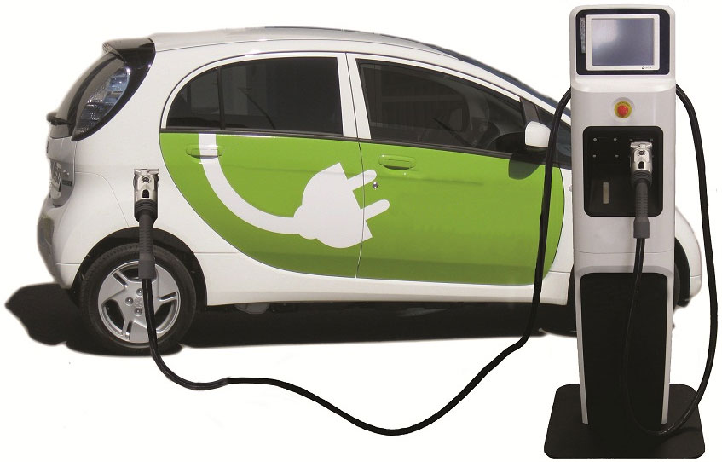
Transportation Sector - Going Electric
How to Change the Demand Curve for Oil and Gasoline
to Prevent Future Oil pipelines
Start slow and small and build into a movement

Slide 55
How to Change the Demand Curve for Oil and Gasoline
to Prevent Future Oil pipelines
Start slow and small and build into a movement
New Tesla Model X base price $86,000 – Range 328 miles on a charge
New Tesla Model S base price $81,000 – Range 373 miles on a charge
New Volve Recharge base price $55,000 - Range 208 miles on a charge
New Ford Mustang Mach E base price $44,000 - Range 300 miles on a charge
New VW ID4 base price $41,000 – Range 353 miles on a charge
New Tesla Model 3 base price $41,000 – Range 220 miles on a charge
New Chevy Bolt base price $37,000 – Range 259 miles on a charge
New Nissan Leaf base price $32,000 – Range 149 miles on a charge
New Mini-electric base price $31,000 -Range 110 miles on a charge
Cost for a new Bolt battery pack $15,000

Slide 56
How to Change the Demand Curve for Oil and Gasoline
to Prevent Future Oil pipelines
Start slow and small and build into a movement
Dozen used EV models for under $20,000
Used Leaf $10,000 new battery set $5,000 = $15,000
Level 2 Charger $2,000
Total used car and charger $17,000
0.34 kWh/ miles
80 miles on a charge

Slide 57
How to Change the Demand Curve for Oil and Gasoline
to Prevent Future Oil pipelines
Start slow and small and build into a movement
Replace your second vehicle with a used EV
40 miles RT for 260 days (5 day work week)
40 miles/day x 5 days/ week x 52weeks/year = 10,400 miles/yr
Drive an ICE vehicle at 25 mpg = 416 gal/ yr
1 gal of gasoline 116,020 Btu - 416 gal = 48.3 MM Btu
416 gal @ $3.20/gal = $5.12/day or $1,331/yr.
416 gal @ $3.40/gal = $5.44/day or $1414/yr.

Slide 58
How to Change the Demand Curve for Oil and Gasoline
to Prevent Future Oil pipelines
Start slow and small and build into a movement
Replace your second vehicle with a used EV
40 miles RT for 260 days (5 day work week)
40 miles/day = 10,400 miles/yr
Typical EV get 0.34 kWh/ mile x 40 miles/day =13.6 kWh / day
13.6 x 5 days/week x 52 weeks/year = 3,536 kWh /yr
1 kWh = 3,412 Btu – 3,526 kWh = 12.1 MM Btu
13.6 kWh/day @ $0.165/kWh = $2.24/day or $584/yr.
Savings $747/yr.
Avoided GHG emissions
(416 x 19.6) – (3,536 X 0.75) = 5,502 lbs or 2.75 T of avoided CO2

Slide 59
How to Change the Demand Curve for Oil and Gasoline
to Prevent Future Oil pipelines
Start slow and small and build into a movement
40 miles RT for 260 days = 3,536 kWh /yr
3,536 kWh / yr / 1,100 kWh / kW installed = 3.21kW
@$3/watt * 3.21 kW = $9,630 - $2503 (26% ITC) = $7,126
$7,126 + $17,000 = $24,126 / $1,632 = 14.8 yrs. (ROI 6.75%)
Total avoided cost of gasoline $1,331 + $301/yr for SRECII = $1632
8,154 lbs (4 T) of avoided CO2 emissions.

Slide 60
32%
43%
Mostly gasoline

Slide 61
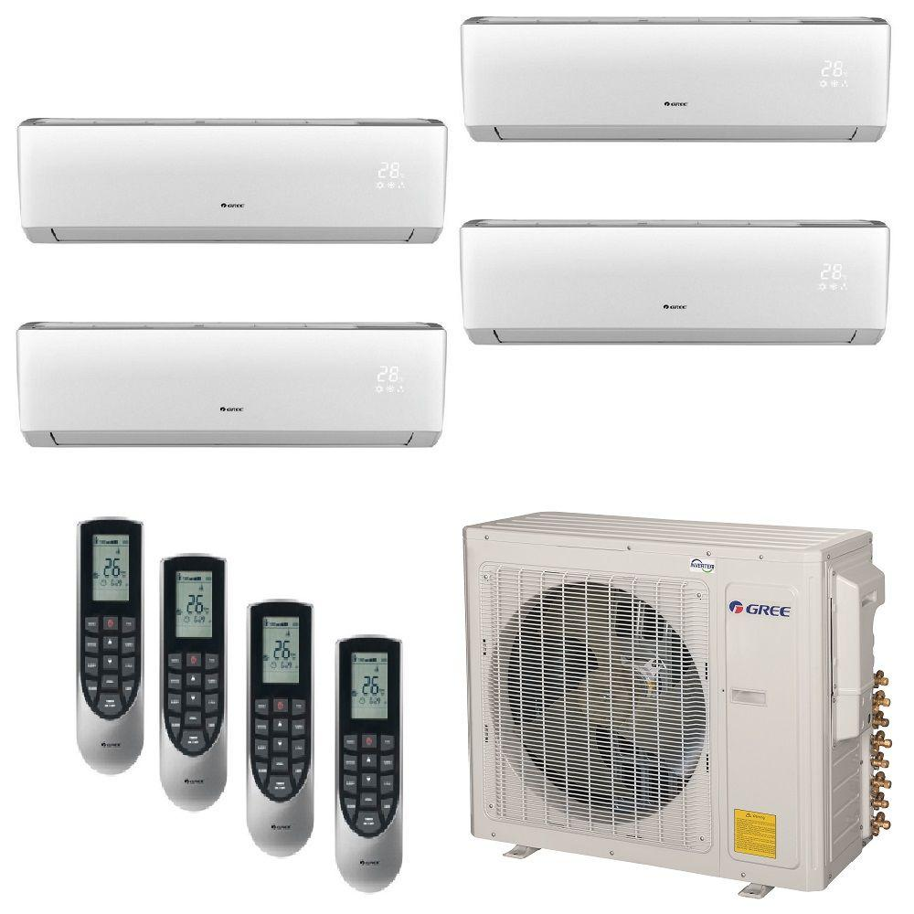
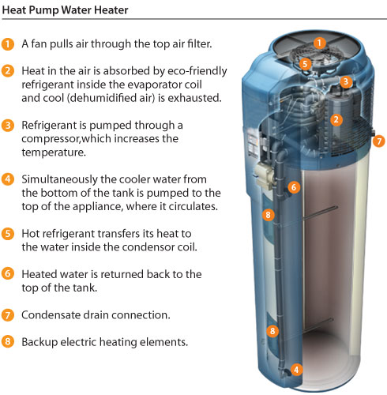
Building Sector - Going Electric
How to Change the Demand Curve for Natural Gas
to Prevent Future Natural gas pipelines
Start slow and small and build into a movement

Slide 62
How to Change the Demand Curve for Natural Gas
to Prevent Future Natural gas pipelines
Start slow and small and build into a movement
HE Gas Water Heater (GWH)
vs a HE Electric Heat Pump Water Heater (EHPWH)
GWH = $1,200 - $150 = $1050
@ 230 therms /yr Operating cost = $250/yr emitting 2,668 lbs of CO2/yr (2.3T)
EHPWH = $2,500 - $750 = $1,750
@ 2,000 kWh/yr Operating cost = $330 /yr emitting 1,000 lbs of CO2/yr (0.5T)
The incremental cost of the EHPWH over the GWH = $750
The additional operating cost of the GWH of the EHPHWH = $80
The additional avoided CO2 emissions of the EHPWH over the GWH = 1,668 (1.8 MT)

Slide 63
How to Eliminate your Fuel Use – How to Prevent Future NG pipelines
Start slow and small and build into a movement –
2,000 kWh /yr. / 1,200 kWh/kW = 1.5 kW of solar
@ $3/W = $4,500 - $1,170 (26% ITC) = $3,330
@ $0.165/kWh = $320/year in avoided electricity costs
2 SREC II @ $90/SREC = $180
$320 (avoided e⁻ cost) + $180 (SREC II) = $500
$3,330 / $500/yr = 6.7 yrs
$5,250 (the incremental cost of the EHPWH + cost of solar w ITC) / $500 = 10.5 years
$7,000 (full cost of EHPWH and solar) / $500 = 14 years
The major advantage is you can store your solar electricity
in an electric heat pump hot water heater

Slide 64
How to Change the Demand Curve for Natural Gas
to Prevent Future Natural gas pipelines
Start slow and small and build into a movement
Per the 2018 Clean Energy Act – the Utilities now manage the HVAC EE programs
HE Electric Heat Pump Water Heater (EHPWH) rebates from
The 4 New Jersey Electric Distribution Co
PSE&G $450
JCP&L $750
ACE $750
RECo $1,000
Same price for a HE Electric Heat Pump Water Heater
Same price to install a HE Electric Heat Pump Water Heater
But different HE Electric Heat Pump Water Heater rebate by Utility area?

Slide 65
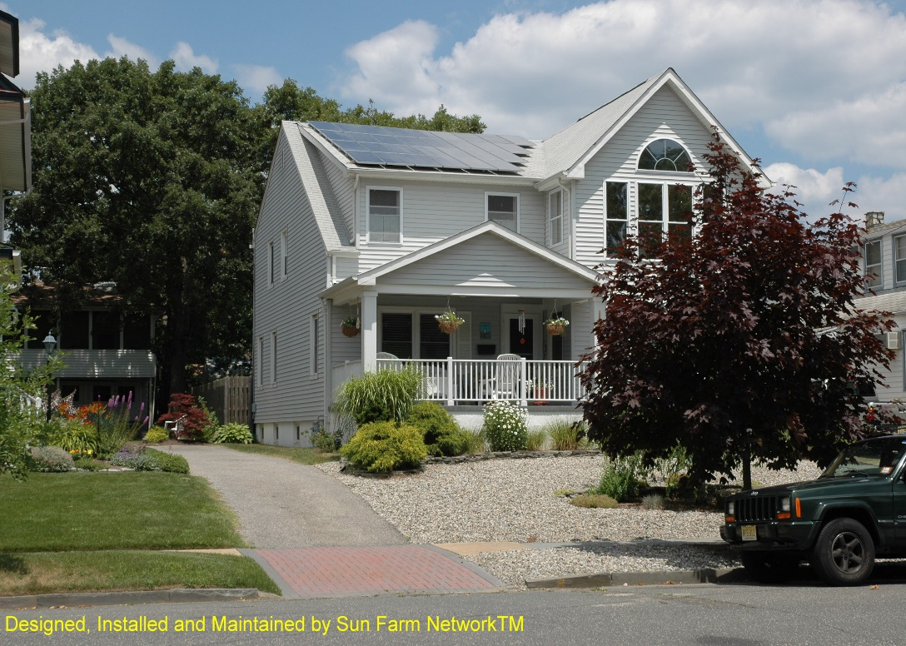
How much solar do I need to power my stuff to light, heat, and cool my home and to charge my EV’s at home to change the demand curves for natural gas and gasoline
Insert Residential Home
7 kW for cooling – 7 kW for heating – 7 kW for 2-EV – 850 sq ft (30’ x 30’)and $63k SPB - 11 years ROI 9%
The average roof is 2,200 sq feet – assuming 50% coverage and 17 sq ft per 300 w panel = 20 kW = 20,000 kWh
Notes:
Residential customers have realized clear benefits as well…..

Slide 66
Month | Solar Radiation( kWh / m2 / day ) | AC Energy( kWh ) | Energy Value( $ )
January | 1.03 | 172 | 31
February | 1.75 | 272 | 49
March | 2.79 | 493 | 89
April | 3.92 | 668 | 120
May | 5.03 | 866 | 156
June | 5.45 | 888 | 160
July | 5.20 | 863 | 155
August | 4.51 | 742 | 134
September | 3.37 | 539 | 97
October | 2.09 | 340 | 61
November | 1.15 | 184 | 33
December | 0.85 | 143 | 26
Annual | 3.10 | 6,170 | $ 1,111
Month | Solar Radiation( kWh / m2 / day ) | AC Energy( kWh ) | Energy Value( $ )
January | 1.87 | 346 | 62
February | 2.68 | 450 | 81
March | 3.62 | 662 | 119
April | 4.48 | 768 | 138
May | 5.40 | 928 | 167
June | 5.73 | 929 | 167
July | 5.45 | 901 | 162
August | 5.03 | 827 | 149
September | 4.19 | 684 | 123
October | 3.10 | 537 | 97
November | 2.01 | 347 | 62
December | 1.61 | 291 | 52
Annual | 3.76 | 7,670 | $ 1,379
Month | Solar Radiation( kWh / m2 / day ) | AC Energy( kWh ) | Energy Value( $ )
January | 1.97 | 363 | 65
February | 2.66 | 443 | 80
March | 3.59 | 653 | 118
April | 4.45 | 762 | 137
May | 5.38 | 923 | 166
June | 5.63 | 910 | 164
July | 5.52 | 913 | 164
August | 5.00 | 822 | 148
September | 4.17 | 678 | 122
October | 3.06 | 526 | 95
November | 1.86 | 318 | 57
December | 1.60 | 288 | 52
Annual | 3.74 | 7,599 | $ 1,368
7 KW north facing at 20º tilt
SPB = 10 years with ITC -
7 KW east facing at 20º tilt
SPB = 8 years with ITC
7 KW west facing at 20º tilt
SPB = 8 years with ITC

Slide 67
NREL U.S. Solar Photovoltaic System and Energy Storage Cost - Benchmark: Q1 2020
The energy generation cost $/kWh decreases as battery storage duration time increase the capital cost $/kW increases
A 4 hour battery cost = $1,364 per kW vs a 1 hour battery cost = $587 per kW vs a ½ hour battery cost of $422 per kW
https://www.nrel.gov/docs/fy21osti/77324.pdf

Slide 68
Some thoughts to help get to 50 X 30
By integrated GHG emissions
mitigation technologies
How many houses, businesses, organization, public institutions in Middletown have solar?
How many of these have EVs?
How many of these have heat pumps?
How can we link these together to install solar, EVs and heat pumps?
How many parking lots/garages can install solar canopies?
How many parking lots/garages can install can install EV charges?
How can we link these together to install solar canopies and EV charges together?
How to get community solar for Middletown low income residents and small businesses?
How can we link community solar with EV charges/heat pumps?
How can we link solar and battery storage for distributed grid reliability and resiliency?
How to collect performance data to educate and advocate change?

Slide 69
Middletown 50 x 30 Green Team Oct 21, 2021
Reasons to be Optimistic
Thank You
Michael Winka
energy translator
mwinka@comcast.net

